Slide 1
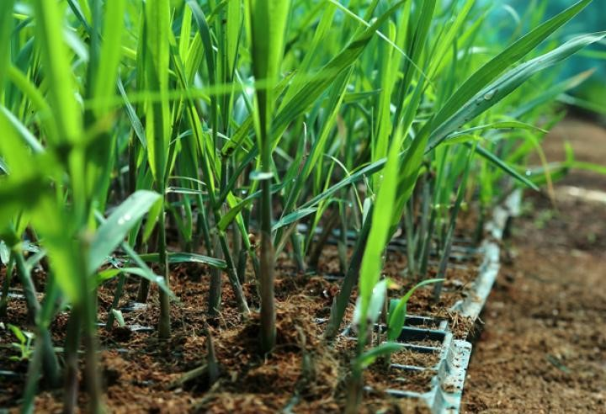


Variety Specific Agronomy of Sugarcane:
A New Concept of Varietal Success
Mehran Sugar Mills Ltd., Tando Allahyar
Rao Saeed Ahmad
M. Sc (Hons) Agri. (UAF)
Lean Six Sigma Certified (IMC-UAE/CPD-UK)
General Manager (Cane & Development)
MEHRAN SUGAR MILLS LTD. www.mehransugar.com

Slide 2

Sugarcane
Introduction:
Pakistan is among the world’s five largest producer of sugarcane as well as cane sugar. The eighth largest consumer of sugar.
Sugarcane is grown on approximately 1.2 million hectares.
Sugarcane is typically grown on the high delta along Pakistan’s major rivers.
The Punjab province accounts for 66 percent of sugarcane production, Sindh 26 percent and KPK 8 percent.
Different research institutes contribute in import of sugarcane fuzz flowed by evaluation, selection and release of new varieties.
Prominent role of Sugarcane Research Institute, AARI, Faisalabad
Release of sugarcane varieties is a laborious and lengthy process.
Due poor performance of different verities in different areas, some lead to disappointment among cane team as well as farmers.
If we do the Root Cause Analysis (RCA), lake of variety specific agronomy is one the reasons of poor performance of new cultivars.
MEHRAN SUGAR MILLS LTD. www.mehransugar.com

Slide 3
Insight of Sugarcane Varieties
>>> Sugarcane varieties approved in the Sindh province are detailed below;
1)- Th-10 (2004) , 2)- Hoth-326 (2019), 3)- Hoth-2109 (2016)
>>> Sugarcane varieties of SRI, Faisalabad approved in the Punjab; and their crops are available in the Sindh province are (out of total 19 varieties);
1)- CPF-237 (2000), 2)- HSF-240 (2002), 3)- SPF-234 (2002), 4)- HSF-242 (2006),
5)- CPF-246 (2011), 6)- CPF-247 (2011), 7)- CPF-249/US-704 (2016),
8)- CPF-250/US-127 (2019), 9)- CPF-251/US-633 (2019), 10)- CPF-253/US-133 (2019)
>>> Sugarcane varieties of SRI, Faisalabad approved in the Punjab and their crops are not available in the Sindh province;
1)- CP-44-33 (1996), 2)- CP-72-2086 (1996) , 3)- CP-77-400 (1996), 4)- CoJ-1184(2000)
5)- SPF-213 (2000) , 6)- SPF-245 (2004), 7)- CPF-243 (2006) , 8)- CPF-248 (2013),
9)- CPF-252/US-658 (2019)
>>> Sugarcane varieties of the Shakarganj Research Institute, Jhang;
1)- SLSG-1283, 2)- SPSG-26, 3)- SPSG-394, 4)- CPSG-2525, 5)- CSSG-676 (unapproved)
>>>A new sugarcane variety released by Fatima Group: YTFG-236 (2023)
MEHRAN SUGAR MILLS LTD. www.mehransugar.com

Slide 4
Sugarcane Varieties
Sugarcane crop mature in 10-14 months. Different varieties behave differently and on the basis of that, these are classified into three categories;
1- Early maturing varieties – mature in 10-12 months
2- Mid maturing varieties – mature in 12-14 months
3- Late maturing varieties – hardly mature after 12 months (non-varieties)
In the past, when cane crop was sufficient to meet crushing capacities of sugar mills and cane crushing seasons had been prolonged for 135-140 days and even more, it was part of Cane Programming to ensure indenting on the basis of sugarcane varieties.
These days when crushing capacities of sugar mills are increased, available crop meet 70-75% need of installed crushing capacity of sugar mills. That resulted shrinking of cane crushing season to 100 days and even below.
In the current scenario, it is need of time to have only early maturing maturity varieties to harvest viable amount of sugar.
MEHRAN SUGAR MILLS LTD. www.mehransugar.com

Slide 5
Categorization of Sugarcane Varieties
1- Early maturing varieties – mature in 10-12 months
  1)- CPF-250 (US-127), 2)- CPF-251 (US-633), 3)- CPF-253 (US-133)
  4)- CPF-237, 5)- CPF-246, 6)- SPF-234, 7)- YTFG-236, 8)- CSSG-676
2- Mid maturing varieties – mature in 12-14 months
  1)- CP-77/400, 2)- HSF-240, 3)- HSF-242, 4)- SPF-213,
  5)- CPF-252 (US-658)
3- Late maturing varieties – hardly mature after 12 months (non-varieties)
  1)- NSG-59, 2)- SPF-238, 3)- Co-1148, 4)- NIA-98
  NSG-59 is appearing as a big challenge in the area.
MEHRAN SUGAR MILLS LTD. www.mehransugar.com

Slide 6
Challenges in Sugarcane Varieties
1- Generalized Agronomic Practices
Same type of recommendations for all varieties;
  Planting geometry > (2.5’ spacing, 4’ spacing, 4.5’ spacing)
  Fertilizer >>>>>>>>> (N:P:K >>> 100 kg:46kg:25kg per acre)
  Irrigation >>>>>>>>> say fortnightly irrigation for all varieties
  Pesticide >>>>>>>>> same dose for all varieties
  Interculture >>>>>>> same trend
2- Early Spreading of seed cane of new varieties
When existing varieties do not perform with the same agronomy, searching and spreading of new varieties is a routine of cane team/ farmers.
Popularity of wild type, late maturing and low recovery germplasms like SPF-238, Co-1148, NGS-59 due to their good yield and ratoon.
MEHRAN SUGAR MILLS LTD. www.mehransugar.com

Slide 7
Area Under Different Sugarcane Varieties
Sr. No. | Varietal Category | Season 2022-23 |  | Season 2023-24 |  | Remarks
 |  | Acres | %age | Acrea | %age
1 | Early Maturing | 49,426 | 83.34% | 40,834 | 77.29% | Decrease
2 | Mid Maturing | 6,670 | 11.25% | 6,467 | 12.24% | Same
3 | Late Maturing | 3,211 | 5.41% | 5,531 | 10.47% | Increase
Total: |  | 59,307 |  | 52,832
Note:
Late maturing and low recover wild cultivar NSG-59 is getting more popularity due to its vigor, ratoon and especially hardness against unfavorable weather conditions.
MEHRAN SUGAR MILLS LTD. www.mehransugar.com

Slide 8
R&D Plan of Mehran Sugar Mills
Topic: Variety Specific Agronomy of Sugarcane
Step-1: Collection and sowing of available germplasm
Step-2: Analysis and Screening of protentional germplasm
Step-3: Sowing of germplasm under uniform environment
    Soil
    Land preparation
    Planting geometry
    Planting time
    Seed rate
    Fertilizer dose
    Irrigation Interval
    Interculture
Step-4: Identification of strength and grey areas of germplasm
Step-5: Recommendations as per need of germplasm
Step-6: Experimental design for validation of recommendations
Step-7: Selection of the most suitable agronomic practices
Step-8: Scale up of the variety specific agronomy
2021-22
2022-23
2023-24
2024-25
MEHRAN SUGAR MILLS LTD. www.mehransugar.com

Slide 9
Varieties Under Trials 2022-23 (Mehran Farm)
Sr. No. | Variety Name | Oct 2nd | Nov 1st | Nov 2nd | Dec 1st | Dec 2nd | Jan 1st | Jan 2nd | Feb 1st | Feb 2nd | Avg Rec
 |  | REC % | REC % | REC % | REC % | REC % | REC % | REC % | REC % | REC %
1 | US-133 | 9.5 | 10.41 | 10.04 | 10.99 | 11.85 | 11.71 | 12.45 | 13.07 | 12.88 | 11.43
2 | US-127 | 10.17 | 10.64 | 10.49 | 11.17 | 12.65 | 12.51 | 12.24 | 13.16 | 13.38 | 11.82
3 | CPF-237 | 9.96 | 10.27 | 9.89 | 10.66 | 11.76 | 12.23 | 11.85 | 12.92 | 12.68 | 11.36
4 | US-633 | 9.97 | 10.77 | 10.92 | 11.29 | 12.61 | 12.56 | 12.77 | 13.19 | 13.18 | 11.92
5 | CSSG-676 | 10.67 | 10.44 | 10.84 | 11.73 | 12.63 | 12.97 | 13.11 | 13.00 | 13.38 | 12.09
6 | CPSG-2525 | 9.33 | 10.50 | 10.58 | 11.19 | 12.04 | 12.32 | 11.98 | 12.67 | 13.24 | 11.54
7 | TH-10 | 8.99 | 9.32 | 9.80 | 10.13 | 10.80 | 11.45 | 11.59 | 12.16 | 12.47 | 10.75
8 | TH-1412 | 9.73 | 9.61 | 10.21 | 11.29 | 11.79 | 12.30 | 12.47 | 11.64 | 13.26 | 11.37
9 | HOTH-2109 | 10.19 | 10.30 | 10.27 | 10.73 | 10.94 | 11.96 | 12.28 | 12.30 | 13.14 | 11.35
10 | LAMTJ-76/803 | 8.39 | 8.22 | 10.27 | 10.22 | 9.64 | 11.16 | 11.54 | 9.76 | 12.38 | 10.18
11 | PSTJ-41 | 10.66 | 8.39 | 7.54 | 9.64 | 9.87 | 10.85 | 9.72 | 10.02 | 11.13 | 9.76
12 | CPTJ-349 | 9.13 | 9.27 | 9.36 | 10.52 | 10.25 | 10.20 | 10.27 | 10.96 | 12.59 | 10.28
13 | TH-1201 | 10.15 | 10.20 | 10.17 | 10.86 | 8.76 | 8.93 | 9.34 | 9.29 | 11.78 | 9.94
14 | YT-910 | 9.40 | 9.32 | 9.77 | 10.91 | 10.42 | 10.76 | 11.67 | 11.97 | 11.70 | 10.66
15 | SPSG-2718 | 10.26 | 9.55 | 9.44 | 9.87 | 11.46 | 11.35 | 11.31 | 12.26 | 10.31 | 10.65
16 | CSSG-32 | 9.84 | 9.35 | 10.85 | 10.40 | 10.58 | 11.62 | 11.31 | 11.42 | 12.02 | 10.82
17 | CPSG-2415 | 9.65 | 10.25 | 10.28 | 11.18 | 11.52 | 11.26 | 11.91 | 12.24 | 11.56 | 11.09
18 | S-2008 M-42 | 10.26 | 8.72 | 9.90 | 10.65 | 11.73 | 11.87 | 12.32 | 11.65 | 12.65 | 11.08
19 | TH-1210 | 8.86 | 10.90 | 9.14 | 10.92 | 11.70 | 12.80 | 12.98 | 11.40 | 11.98 | 11.19
20 | CP-77400 | 9.80 | 9.33 | 9.18 | 9.96 | 10.68 | 11.78 | 10.77 | 11.39 | 12.59 | 10.61
21 | CPSG-3481 | 9.55 | 7.89 | 9.57 | 9.90 | 9.39 | 11.33 | 12.55 | 10.86 | 12.65 | 10.41
22 | CPSG-2730 | 10.77 | 9.51 | 10.57 | 9.57 | 10.64 | 10.92 | 11.83 | 12.11 | 11.97 | 10.88
MEHRAN SUGAR MILLS LTD. www.mehransugar.com

Slide 10
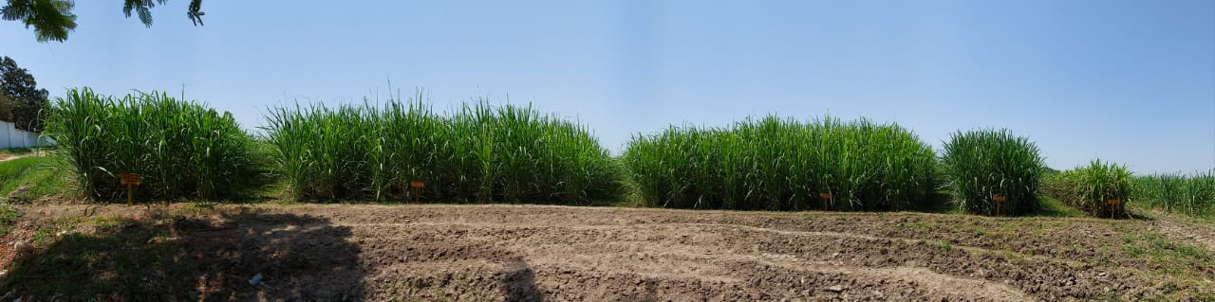
Varietal Behavior under Same Condition
May 04, 2023
CPF-253
CP00-1101
CPSG-1591
CPF-250
SPF-234
Related Information
Location: Mehran Sugar mills Farm
Date of Sowing: Mid of Sept. 2023
Basal Fertilizer: DAP: 2 bags, SOP: 1 bag
Subsequent Urea: 3 bags
De-trashing: as per need
Irrigation: As per need – just like commercial fields.
Interculture: 2 times - manual.
MEHRAN SUGAR MILLS LTD. www.mehransugar.com

Slide 11
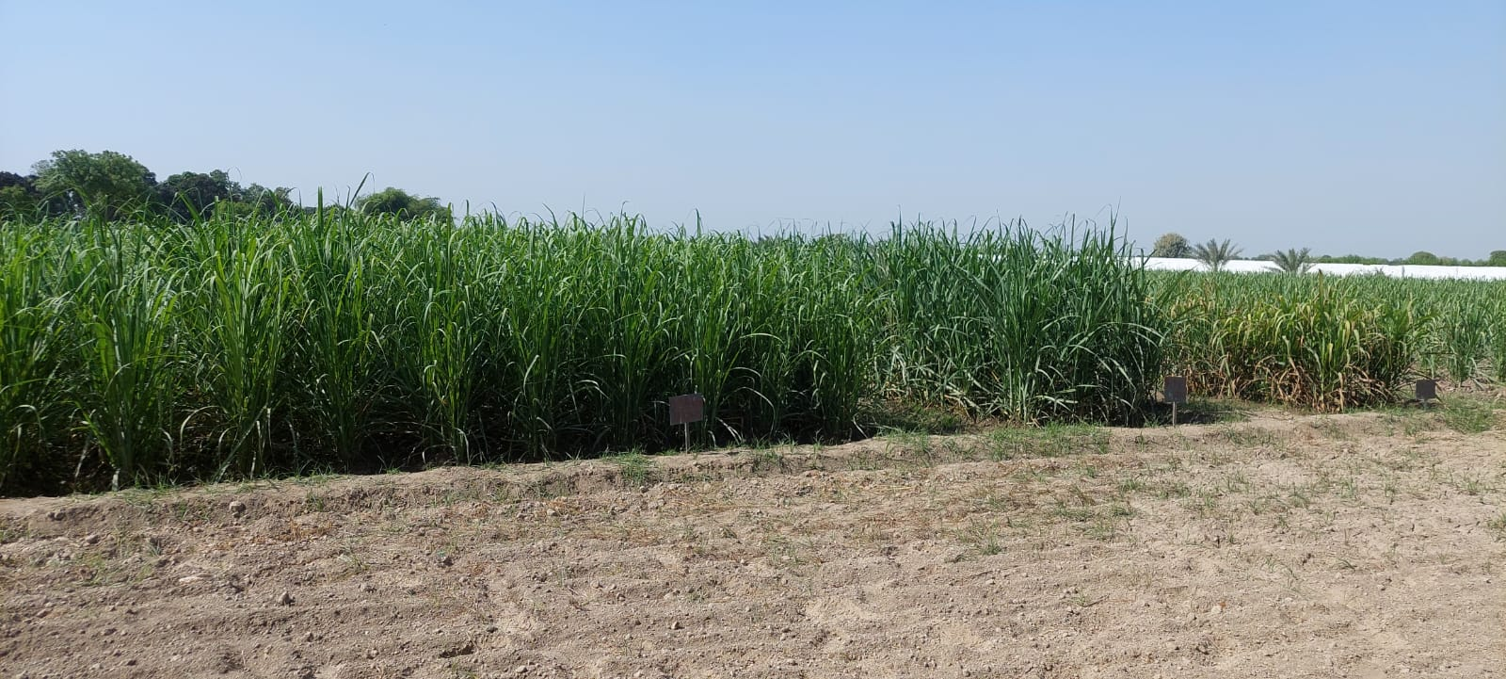
Varietal Behavior under Same Condition
CPSG-1591
CPF-250
SPF-234
Lush Green
Dark Green
Pale Green
Color Display of Different Varieties
Basic/ General Guideline for Application of Irrigation and Nitrogen
MEHRAN SUGAR MILLS LTD. www.mehransugar.com

Slide 12
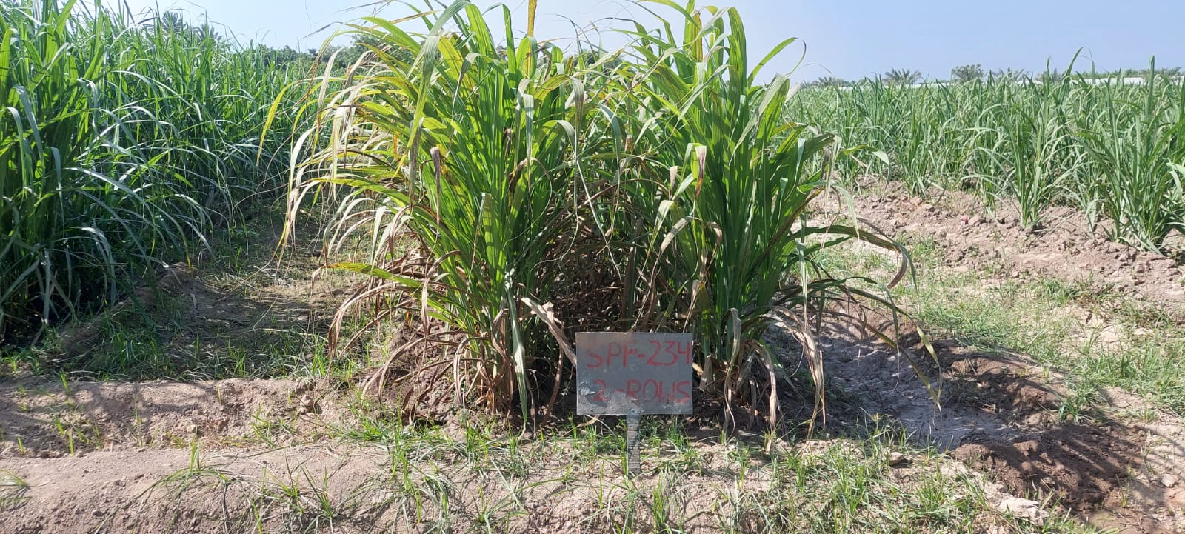
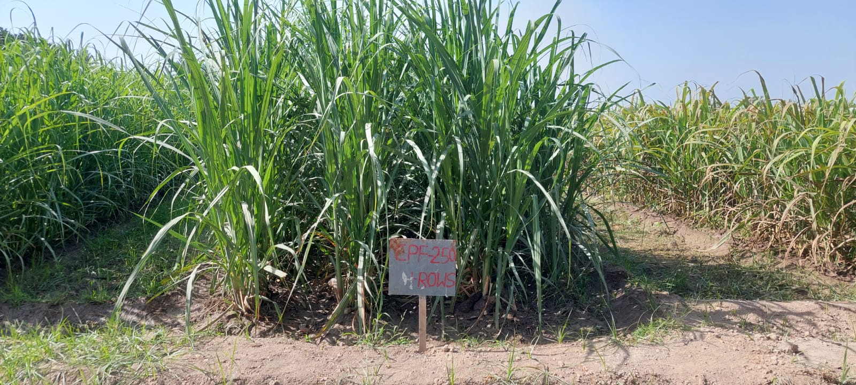
Varietal Behavior under Same Condition
SPF-234
CPF-250
MEHRAN SUGAR MILLS LTD. www.mehransugar.com

Slide 13
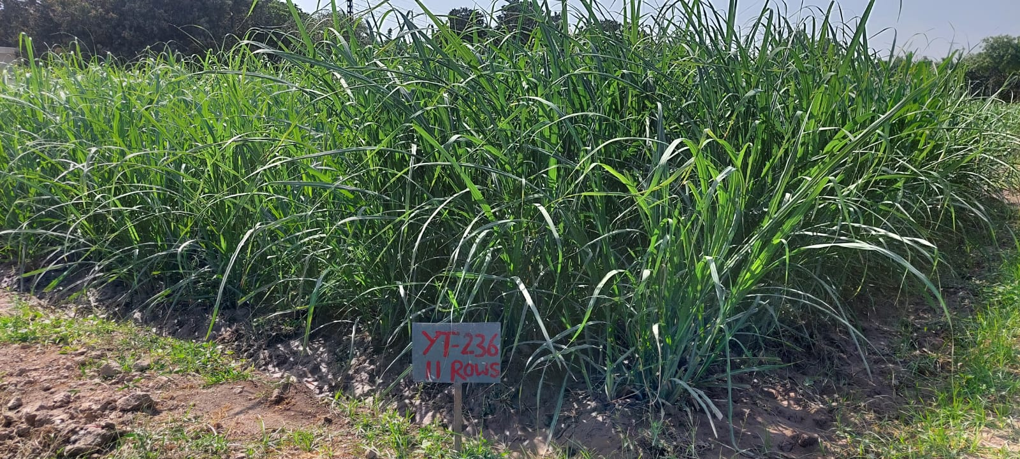
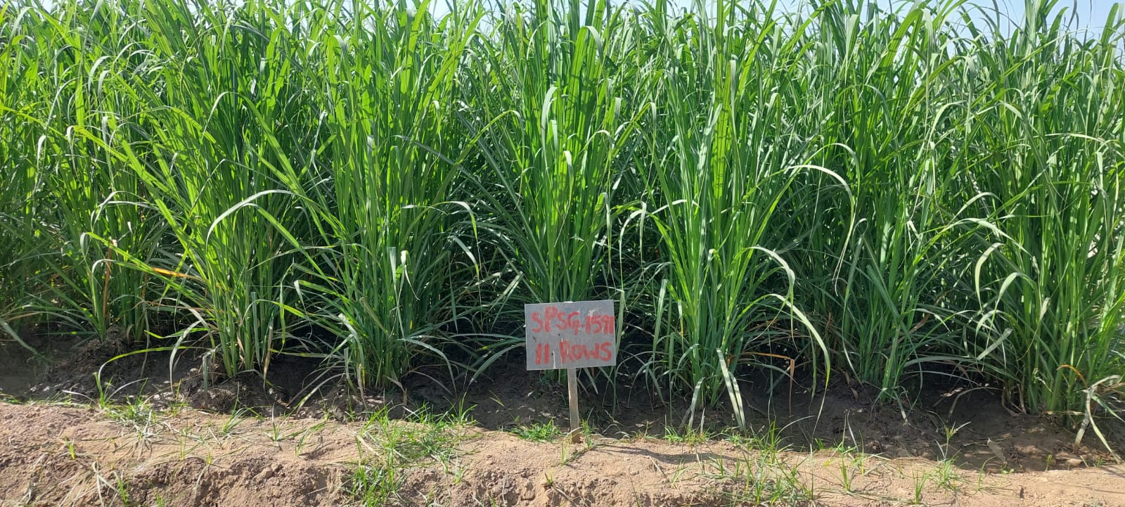
Varietal Behavior under Same Condition
YTFG-236
SPSG-1591
MEHRAN SUGAR MILLS LTD. www.mehransugar.com

Slide 14
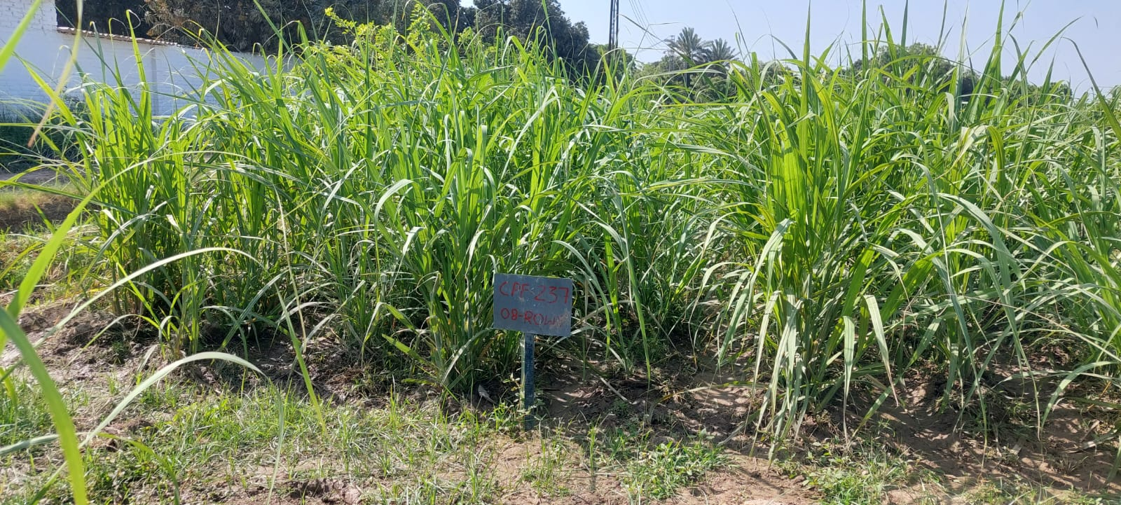
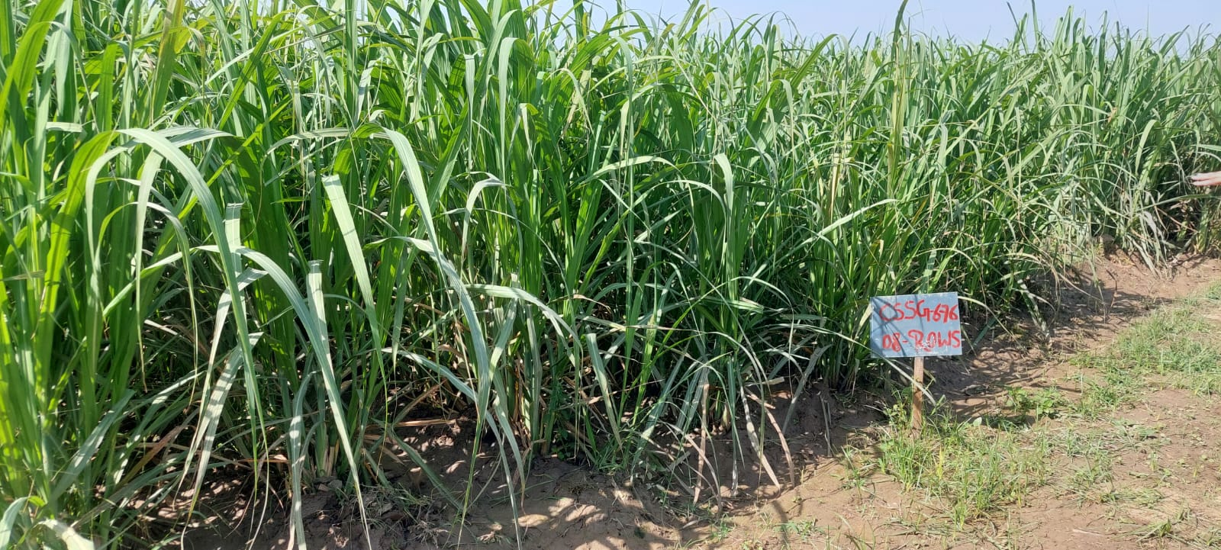
Varietal Behavior under Same Condition
CPF-237
CSSG-676
MEHRAN SUGAR MILLS LTD. www.mehransugar.com

Slide 15
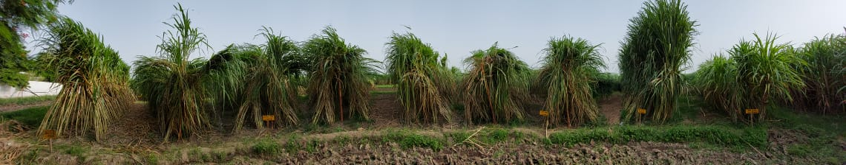
Varietal Behavior under Same Condition
May 04, 2023
July 31, 2023
CPF-253
CP00-1101
CPSG-1591
CPF-250
SPF-234
MEHRAN SUGAR MILLS LTD. www.mehransugar.com

Slide 16
Growth Trend of Different Varieties
Sr. No. | Variety | Average Length of Cane Stick (Ft) | No. of Nodes | No. of Nodes/ 1 Ft Length | Growth Trend | Remarks
1 | SPF-234 | 6.17 | 23 | 3.73 | Week | Check-1
2 | CPF-237 | 9.00 | 22 | 2.44 | Average | Check-2
3 | CPSG-1591 | 9.83 | 22 | 2.24 | Average
4 | CSSG-3481 | 9.83 | 22 | 2.24 | Average
5 | CPF-253 | 10.50 | 26 | 2.48 | Good | Available
6 | CP00-1101 | 10.75 | 23 | 2.14 | Good
7 | YTFG-236 | 10.80 | 20 | 1.85 | Good
8 | CSSG-676 | 11.20 | 28 | 2.50 | Extra | Available
9 | CPF-250 | 11.25 | 22 | 1.96 | Extra | Available
MEHRAN SUGAR MILLS LTD. www.mehransugar.com

Slide 17
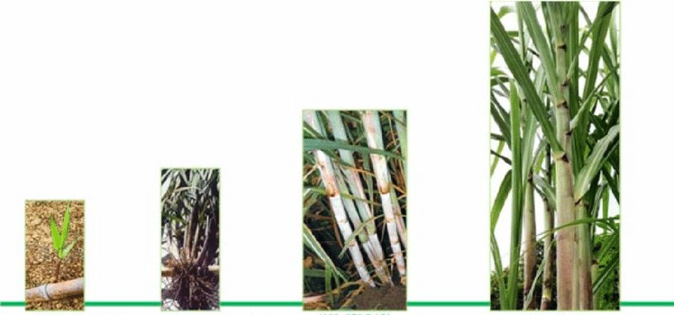
Critical Stage to Fine Tune the Agronomy
Establishment
(0-45 Days)
Vegetative
(45-120 Days)
Grand Growth
(120-250 Days)
Ripening
(250-360 Days)
Critical Stage to Fine Tune
(0 - 150 Days)
Irrigation
Fertilizer Dose
Planting Geometry
Seed Rate
MEHRAN SUGAR MILLS LTD. www.mehransugar.com

Slide 18
Observation Notes on Different Varieties
Sr. No. | Variety | Observation Note | Problems | Recommendations
1 | SPF-234 | Good germination and tillering Slow growth and low vigor | Rust suppress the growth for 40-60 days. White Fly and Stem Borer infestation | Addition of Sulphur in nutrition plan. Additional NPK Use of fungicide
2 | CSSG-676 | Good germination and tillering Very good growth Healthy cane sticks | Mild infestation of Rust (White Leaf is also reported from field) | Increase of P & K. Addition of Sulphur in nutrition plan. Plantation at wider space
3 | CPF-253 | Very Good germination and tillering Very good growth Healthy cane sticks Low trend of lodging | No issue observed. Good performance | Addition of Phosphorus Controlled Nitrogen
4 | CPF-237 | Good growth Healthy cane sticks No disease or pest | Less germination and tillering Issue of pith formation | Increased rate of seed cane Additional dose of K to over come pith formation.
5 | CPSG-1591 | Very good germination and tillering Very good growth Below average health of cane sticks | Cane sticks are comparatively thin. Incident of Whip Smut Under observation in this regard. | Additional dose of PK & S Early earthing up to focus on mother shoots and reduce subsequent tillering. Drop in Nitrogen dose.
MEHRAN SUGAR MILLS LTD. www.mehransugar.com

Slide 19
Observation Notes on Different Varieties
Sr. No. | Variety | Observation Note | Problems | Recommendations
6 | CSSG-3481 | Good germination and tillering Dark green color Average health of cane Stick | Mild infestation of Rust Under observation in this regard. | Addition of Phosphorus and Sulphur. Drop in Nitrogen dose.
7 | CP00-1101 | Very Good germination and tillering Very good growth Healthy cane sticks | An incident of Whip Smut observed. Under observation in this regard. | Addition of Phosphorus and Sulphur.
8 | CPF-250 | Extra vigorous growth Dark green color Healthy cane stick | Rapid growth lead to more Hight and lodging Average tillering | Controlled N and irrigation to avoid extra growth Additional seed cane rate
9 | YTFG-236 | Very Good germination and tillering. Dark green color of the crop Very good growth Healthy cane sticks | No issue is observed in the crop. Need to see into recovery data. High trend of lodging | Due to high tillering, seed rate may be reduced. Drop in N application.
MEHRAN SUGAR MILLS LTD. www.mehransugar.com

Slide 20

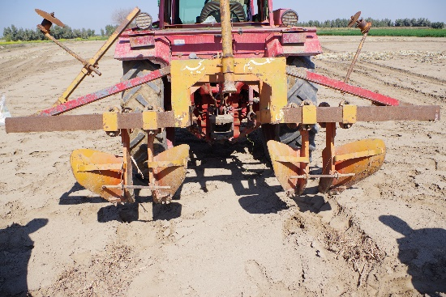
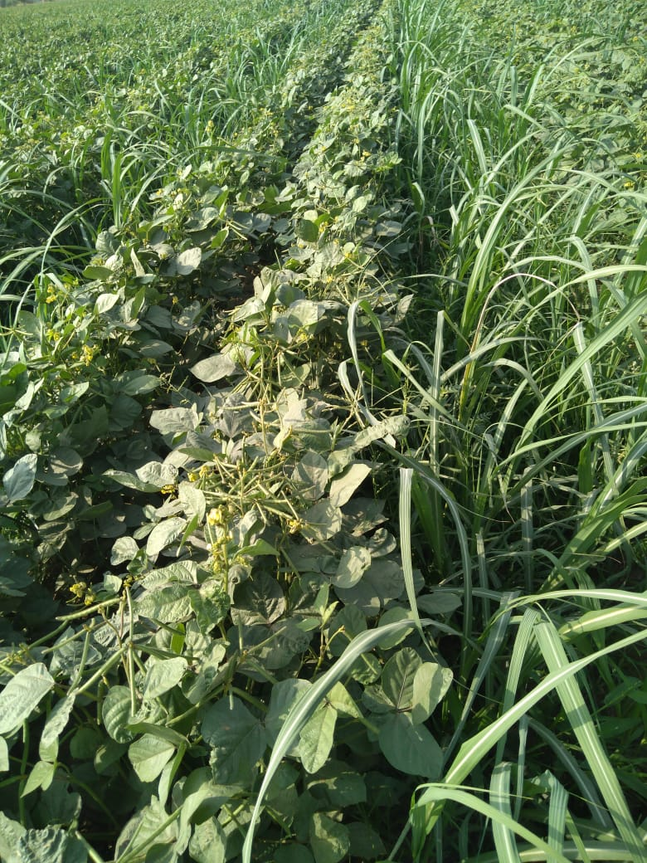
Validation Trials 2023-24
1- Different Dose of Nutrition
Different doses of NPK
Additional of Sulphur
2- Different Planting Geometry
2.5 feet spacing
4 feet spacing
3- Intercropping
Wheat
Canola/ Sarsoon
Onion
Experimental Design: RCBD for scientific validation of the results
Plantation: September Sowing, 2023
Location: Mehran Research Farm
MEHRAN SUGAR MILLS LTD. www.mehransugar.com

Slide 21
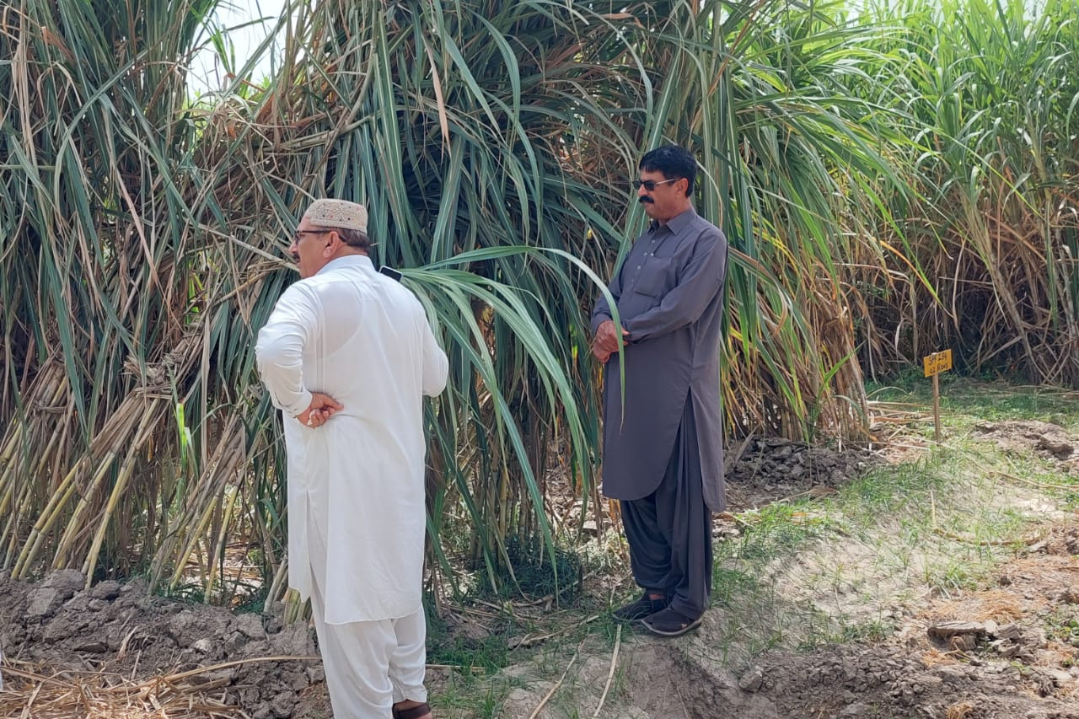
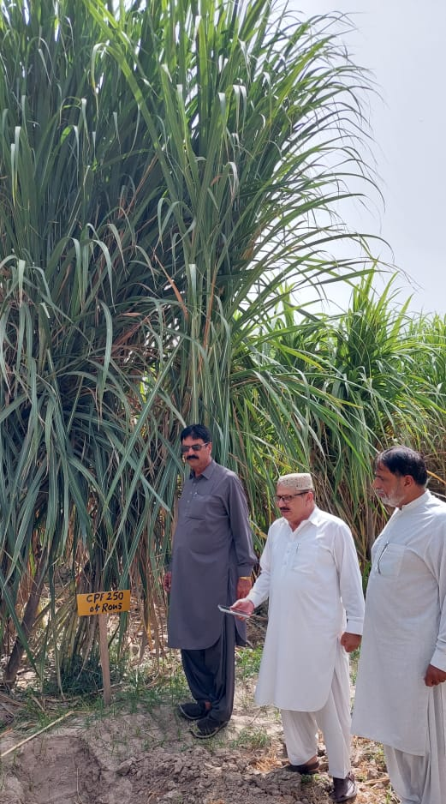
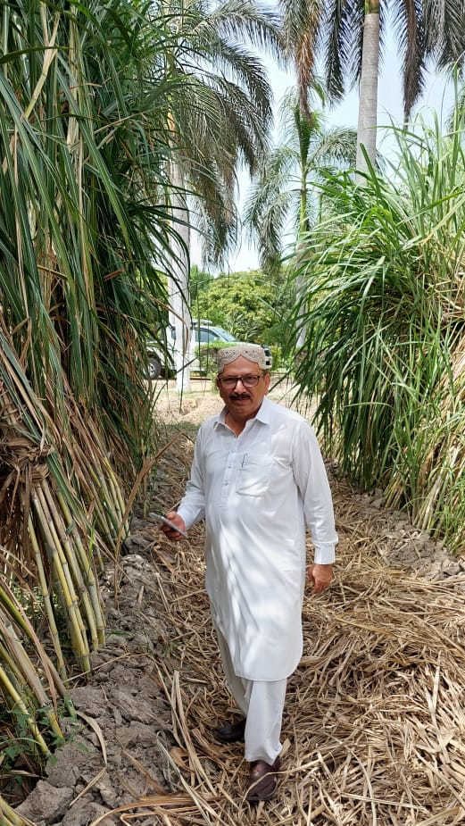
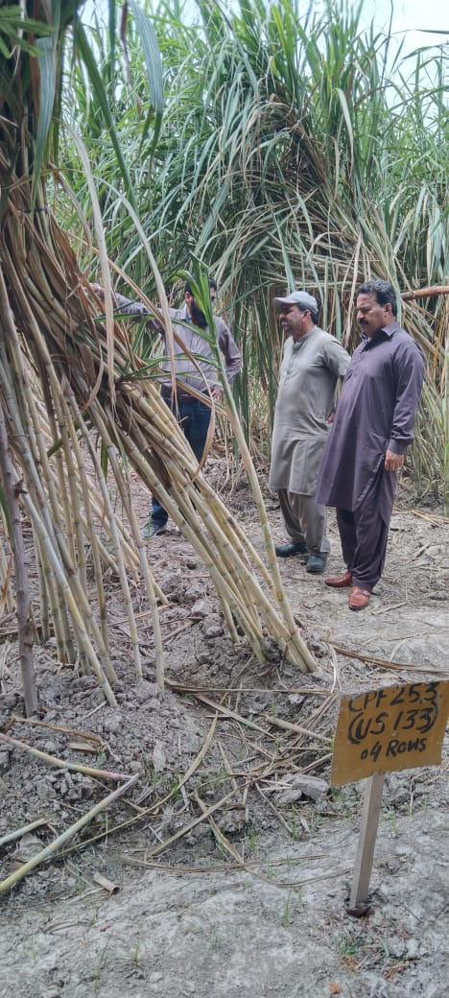
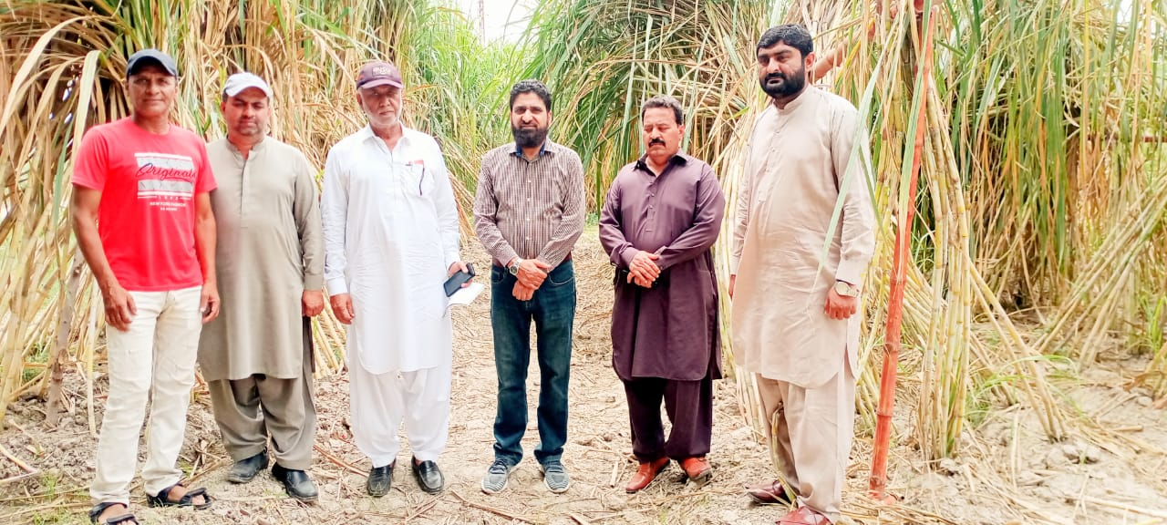
Visitors of Varietal Trials
MEHRAN SUGAR MILLS LTD. www.mehransugar.com

Slide 22
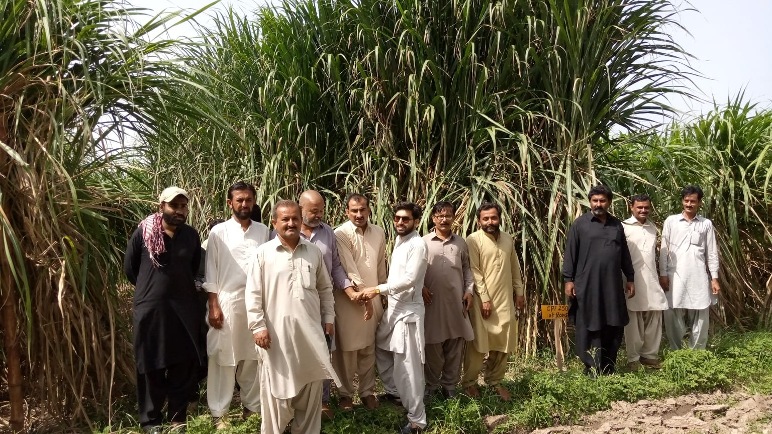
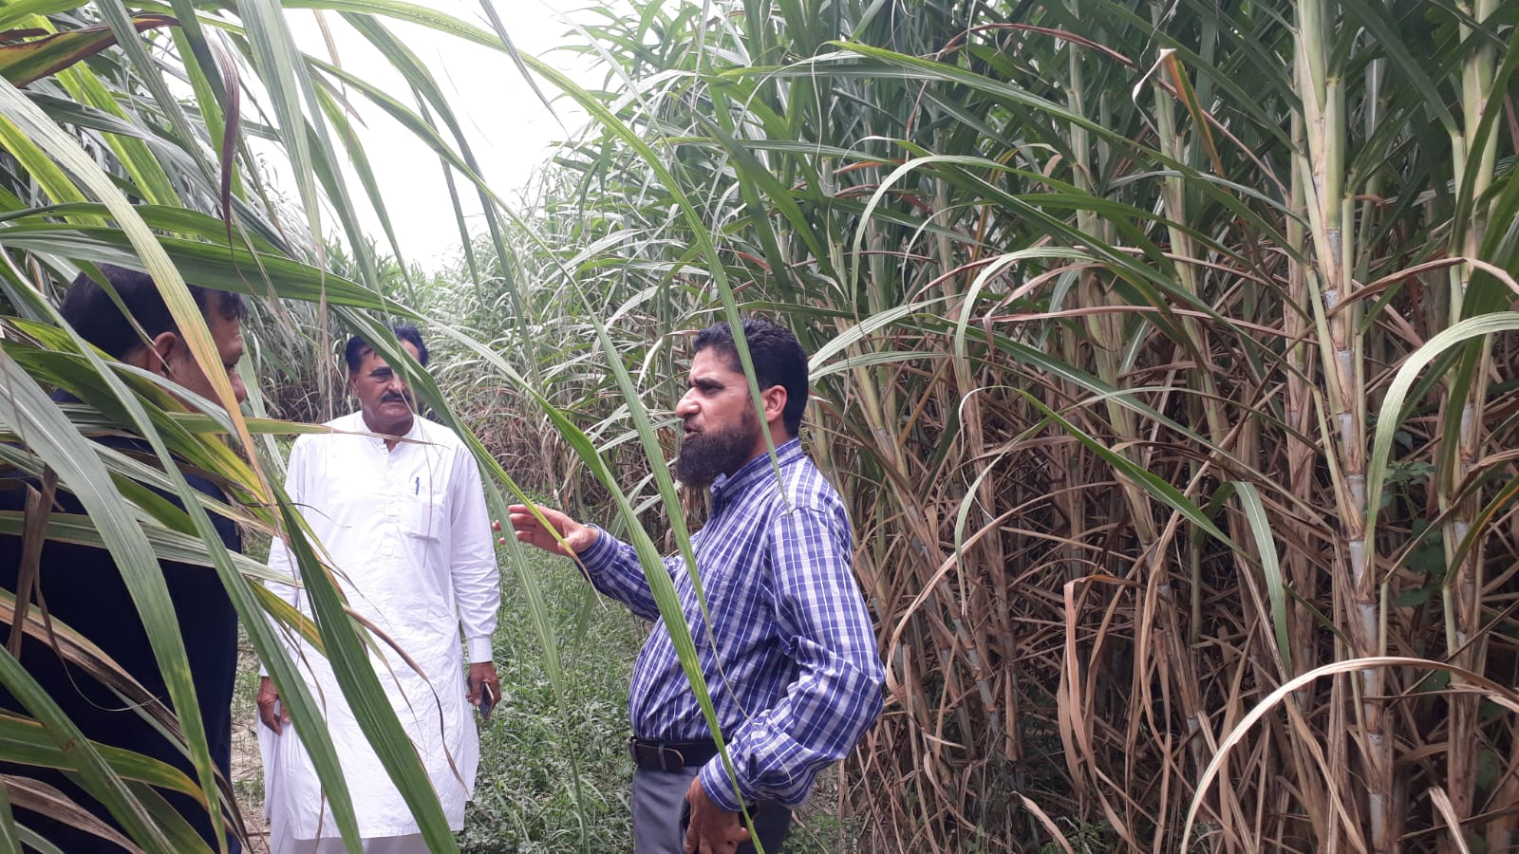
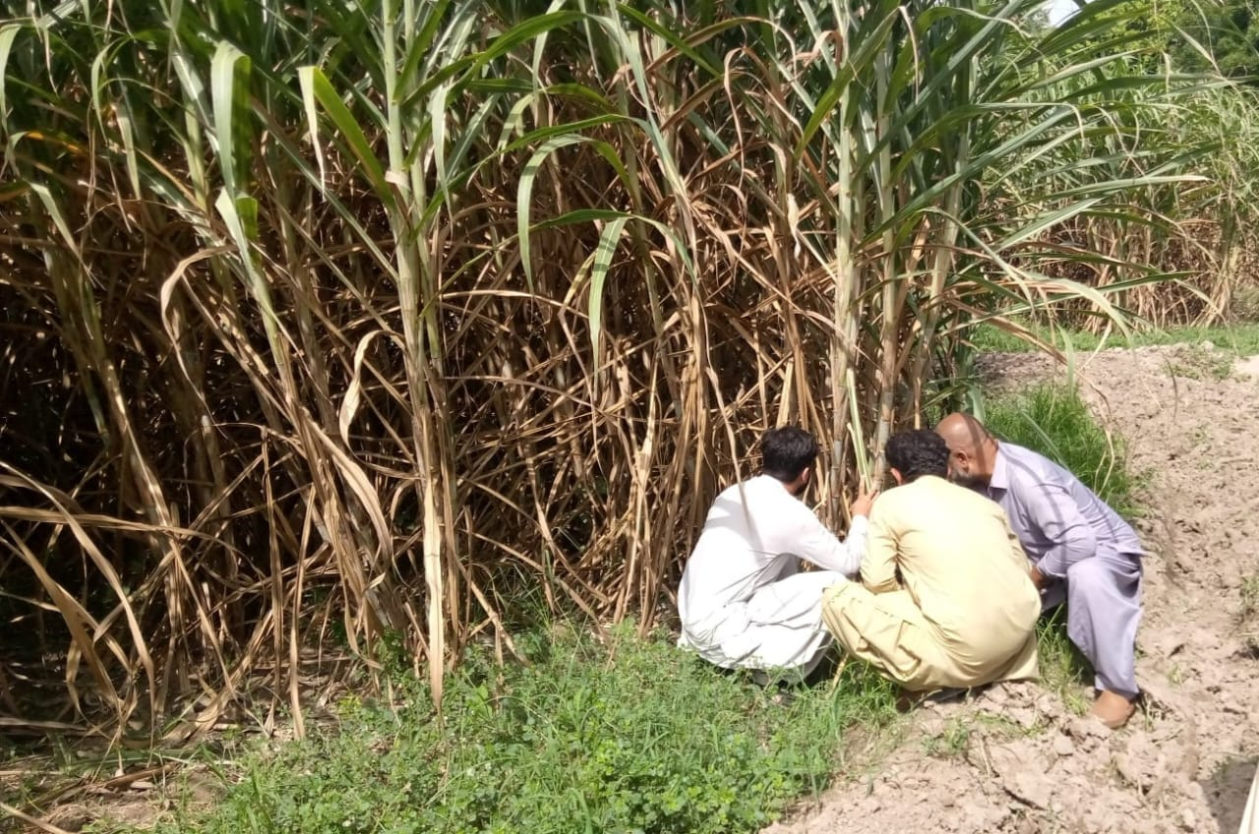
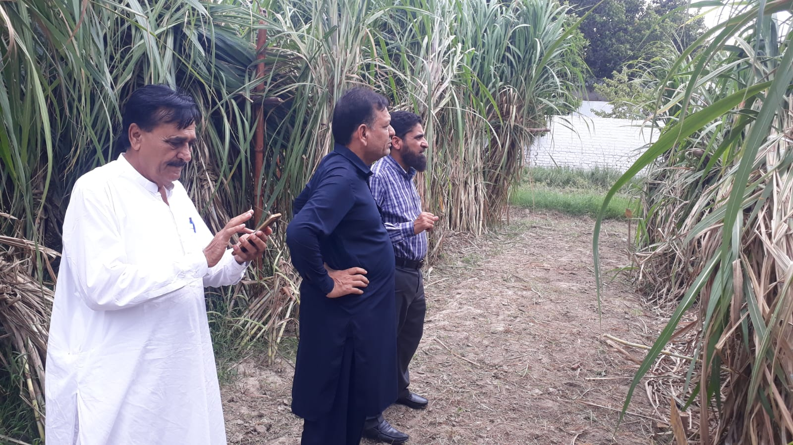
Visitors of Varietal Trials
MEHRAN SUGAR MILLS LTD. www.mehransugar.com

Slide 23
THANKS
MEHRAN SUGAR MILLS LTD. www.mehransugar.com

